Slide 1
Confidence Intervals : Means
Chapter 22 CI

Slide 2

Quantitative Data
Population Parameters
Sample Statistics
$μ=\text{mean}$
$σ=\text{standard} \text{deviation}$
$\overline{x}=\text{mean}$
$s_{x}=\text{standard} \text{deviation}$

Slide 3
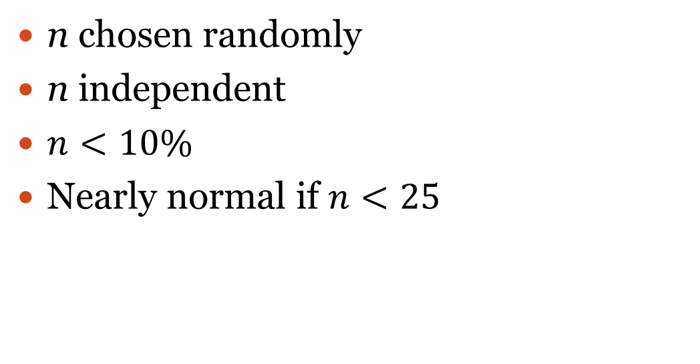
Assumptions/Conditions
n chosen randomly
n independent
$n<10\%$
Nearly normal if $n<25$
n = sample size

Slide 4
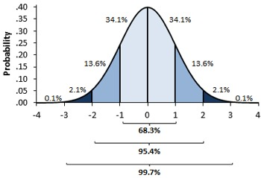
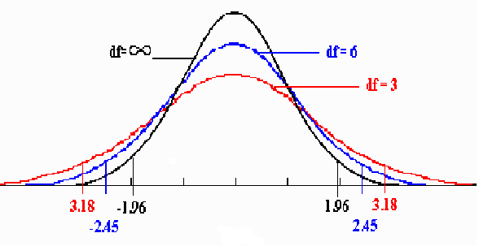
Z vs T
z- distribution
t-distribution
Use when σ is unknown
Degrees of freedom =$n−1$
Use when σ is known

Slide 5
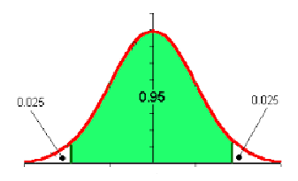
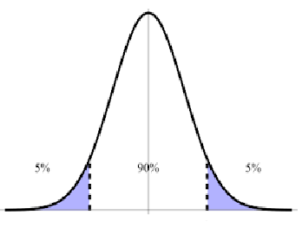
Confidence Interval
Procedure: Use sample to make a prediction about mean of population
95% Confidence Interval
Left area = 0.025
90% Confidence Interval
Left area = 0.05

Slide 6
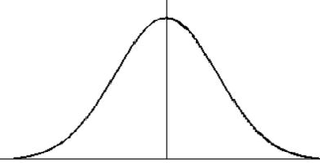
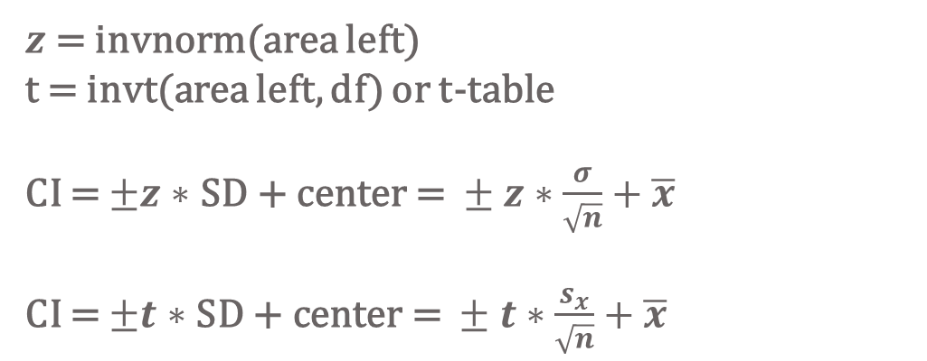
$z$ = invnorm(area left) t = invt(area left, df) or t-table CI = $±z∗\text{SD}\text{ + }\text{center}\text{ = }±z∗\frac{σ}{\sqrt{n}}+\overline{x}$ CI = $±t∗\text{SD}\text{ + }\text{center}\text{ = }±t∗\frac{s_{x}}{\sqrt{n}}+\overline{x}$
Count = SD = $\frac{σ}{\sqrt{n}}$
Use z-distribution
Count = SE = $\frac{s_{x}}{\sqrt{n}}$
Use t-distribution
df = n – 1
$$\overline{x}$$
2nd VARS #3
2nd VARS #4

Slide 7
Conclusions
We say…
We don’t say…
We are __% confident that the true mean of __ is between __ and __.
We expect __% of all possible confidence intervals calculated with sample size n to contain the true mean of the population.
There is a __% chance of a particular value in the interval.
There is a __% chance the mean of the population is in the interval.

Slide 8
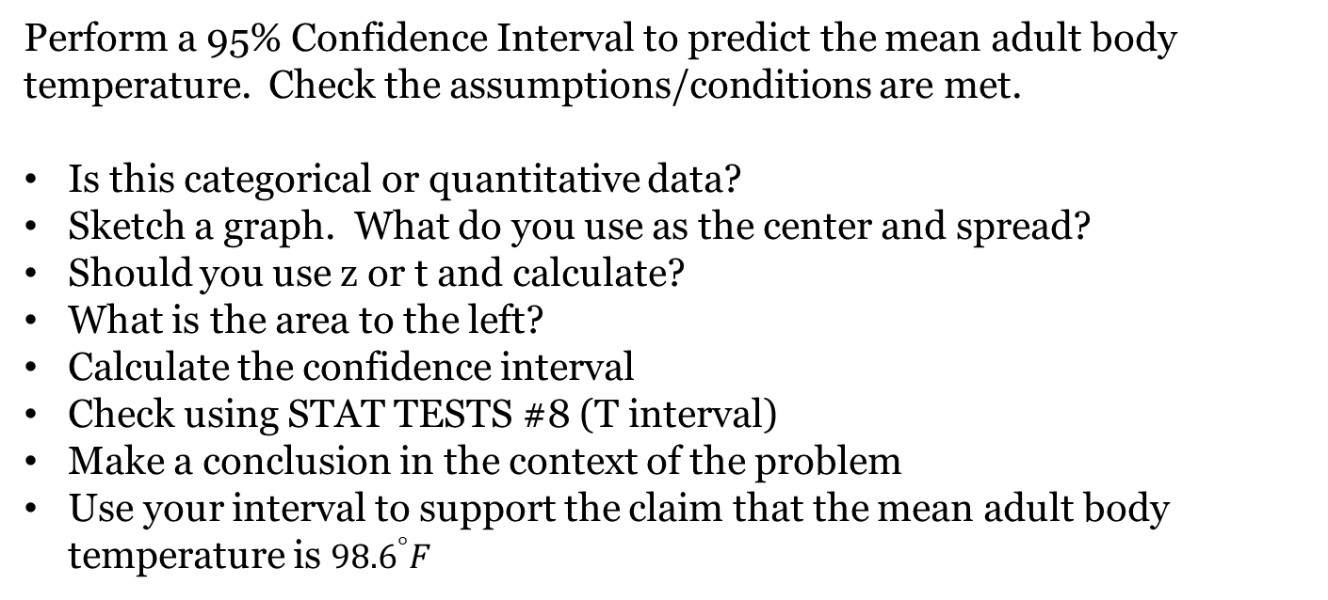
Ex 1: Mean Adult Body Temperature
Perform a 95% Confidence Interval to predict the mean adult body temperature. Check the assumptions/conditions are met.
Is this categorical or quantitative data?
Sketch a graph. What do you use as the center and spread?
Should you use z or t and calculate?
What is the area to the left?
Calculate the confidence interval
Check using STAT TESTS #8 (T interval)
Make a conclusion in the context of the problem
Use your interval to support the claim that the mean adult body temperature is ${98.6}^{°}F$

Slide 9
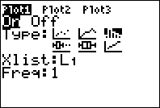
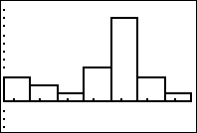
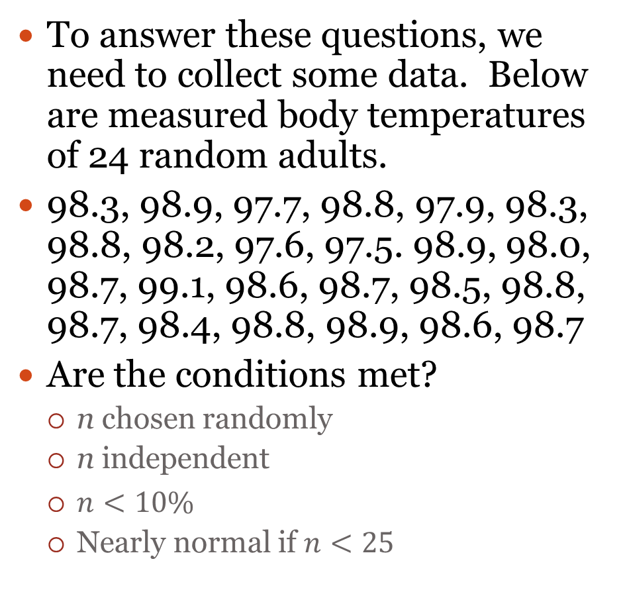
Ex 1
To answer these questions, we need to collect some data. Below are measured body temperatures of 24 random adults.
98.3, 98.9, 97.7, 98.8, 97.9, 98.3, 98.8, 98.2, 97.6, 97.5. 98.9, 98.0, 98.7, 99.1, 98.6, 98.7, 98.5, 98.8, 98.7, 98.4, 98.8, 98.9, 98.6, 98.7
Are the conditions met?
n chosen randomly
n independent
$n<10\%$
Nearly normal if $n<25$
STAT EDIT#1
STATPLOT #1
ZOOM #9

Slide 10
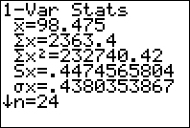
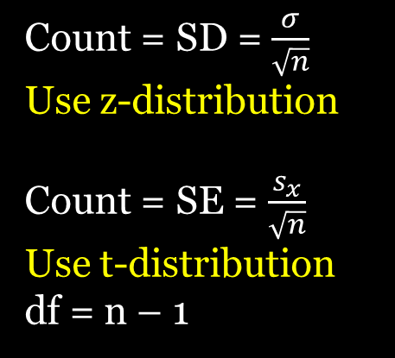
Ex 1
Is this categorical or quantitative data?
Sketch a graph. What do you use as the center and spread?
Should you use z or t and calculate?
Count = SD = $\frac{σ}{\sqrt{n}}$
Use z-distribution
Count = SE = $\frac{s_{x}}{\sqrt{n}}$
Use t-distribution
df = n – 1
$$center=\overline{x}=98.5 S_{x}=0.447$$
$$SE=\frac{0.447}{\sqrt{24}}=0.0912434929≈0.09=count$$
STAT CALC #1
Mean Adult Body Temp
t-distribution
df= n-1 = 23
98.5
98.59
98.77
98.41
98.68
98.32
98.23

Slide 11
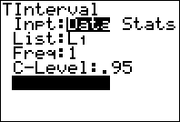
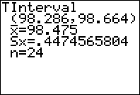
Ex 1
What is the area to the left?
Calculate the confidence interval
Check using STAT TESTS #8 (T interval)
STAT TESTS #8
2.5%
95%
2.5%
Mean Adult Body Temp
t-distribution
df= n-1 = 23
98.5
98.59
98.77
98.23
98.41
98.68
98.32
t = invt(area left, df) = invt(0.025, 23) = -2.069
CI = $±t∗\text{SD}\text{ + }\text{center}$ = $±$2.069* $0.09+98.5$
= (98.31379, 98.68621)

Slide 12
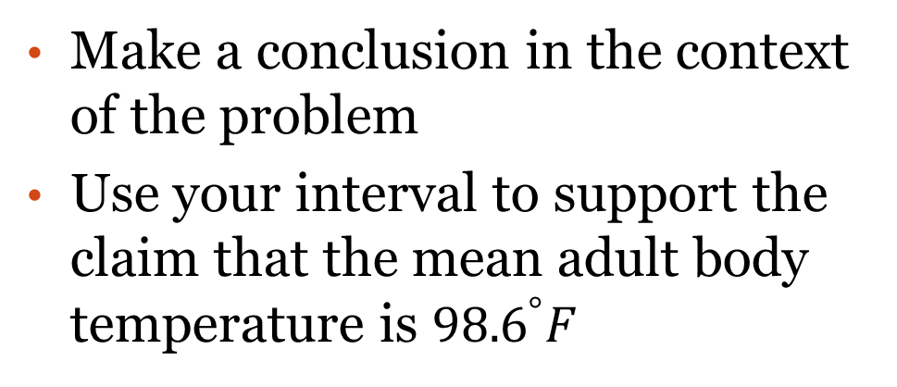
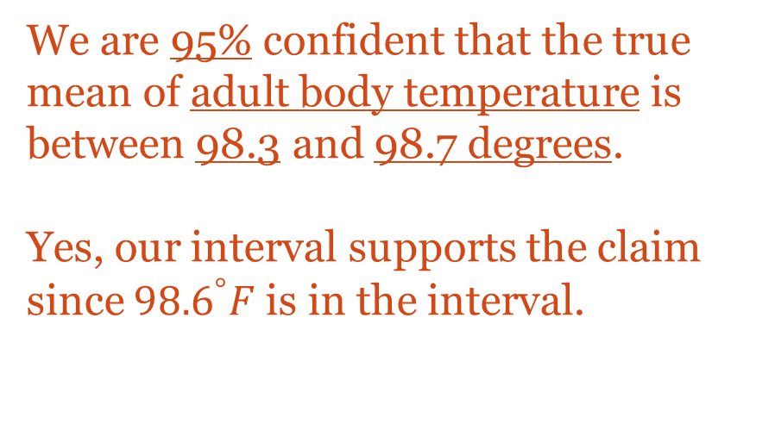
Ex 1
Make a conclusion in the context of the problem
Use your interval to support the claim that the mean adult body temperature is ${98.6}^{°}F$
We are 95% confident that the true mean of adult body temperature is between 98.3 and 98.7 degrees.
Yes, our interval supports the claim since ${98.6}^{°}F$ is in the interval.

Slide 13
Ex 2: Valencia Class Size
Valencia college boasts about having small class sizes and states the average class size is 23 students on their webpage. From a random sample of 41 classes on east campus, the average number of students per class was 22.2 with a standard deviation of 4.2. Perform a 95% Confidence Interval to determine if it is different from reported by Valencia.
Conditions/assumptions met?
Is this categorical or quantitative data?
Sketch a graph. What do you use as the center and spread?
Should you use z or t and calculate?
What is the area to the left?
Calculate the confidence interval
Check using STAT TESTS #8 (T interval)
Make a conclusion in the context of the problem

Slide 14
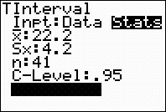
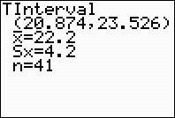
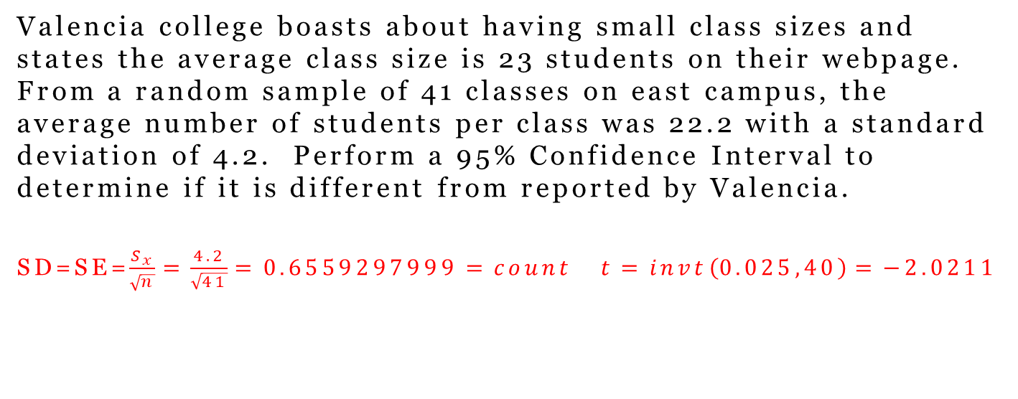
Ex 2: Valencia Class Size
Valencia college boasts about having small class sizes and states the average class size is 23 students on their webpage. From a random sample of 41 classes on east campus, the average number of students per class was 22.2 with a standard deviation of 4.2. Perform a 95% Confidence Interval to determine if it is different from reported by Valencia.
SD=SE=$\frac{S_{x}}{\sqrt{n}}=\frac{4.2}{\sqrt{41}}=0.6559297999=count t=invt\left(0.025,40\right)=−2.0211$
$$μ=23 \overset{̿}{x}=22.2=center S_{x}=4.2 n=41 df=40$$
$$\text{CI}\text{ = }±t∗\text{SD}\text{ + }\text{center}\text{ = (20.874, 23.526)}$$
Since 23 is in the interval, there is evidence to support Valencia’s claim.
Check using STAT TESTS #8

